Slide 1
Message broadcasting
Web socket, encrypt and decrypt the data both “At Transit” and “At Rest”

Slide 2
Technology & Platform
Platform: Java, Spring Boot, Thymeleaf, Junit
Documents: Web Socket Architecture, Cucumber Report
Plugins: JWT, Cucumber, TestNG, Web Socket

Slide 3
Points Covered
Web socket is used to send one to one and to broadcast message within application and to another application.
UI to send direct and broad cast message.
JWT crypt algorithm is used to encrypt and decrypt the data both “At Transit” and “At Rest”.
Followed the BDD approach with cucumber features, TestNG and generated the usage and overview report.

Slide 4
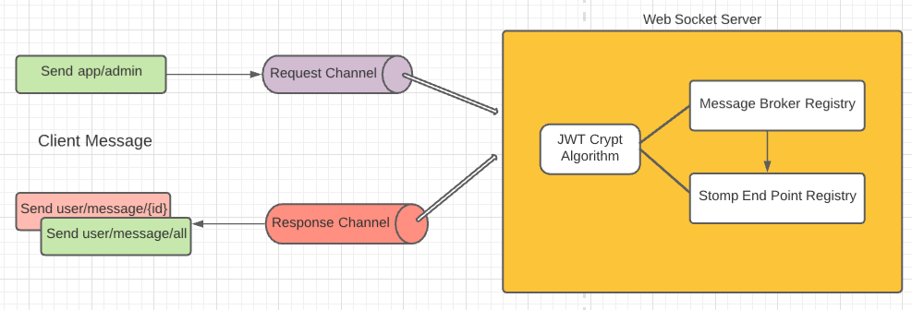
Web socket architecture

Slide 5
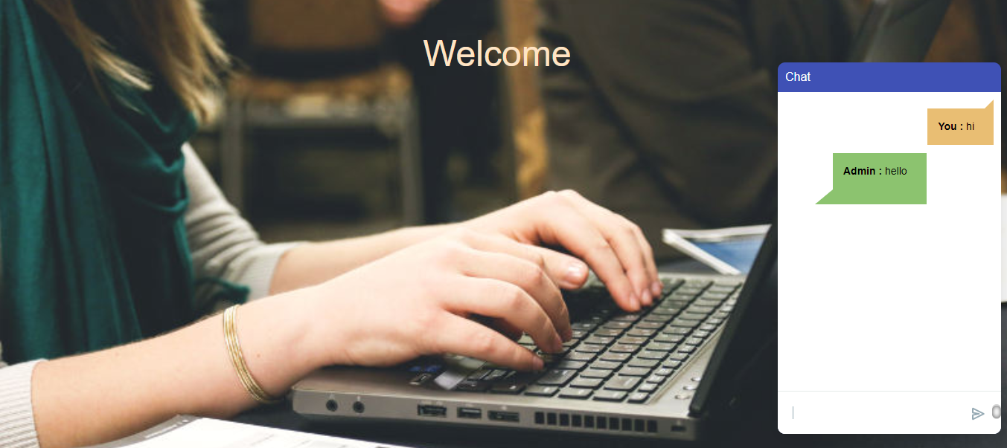
USER end

Slide 6
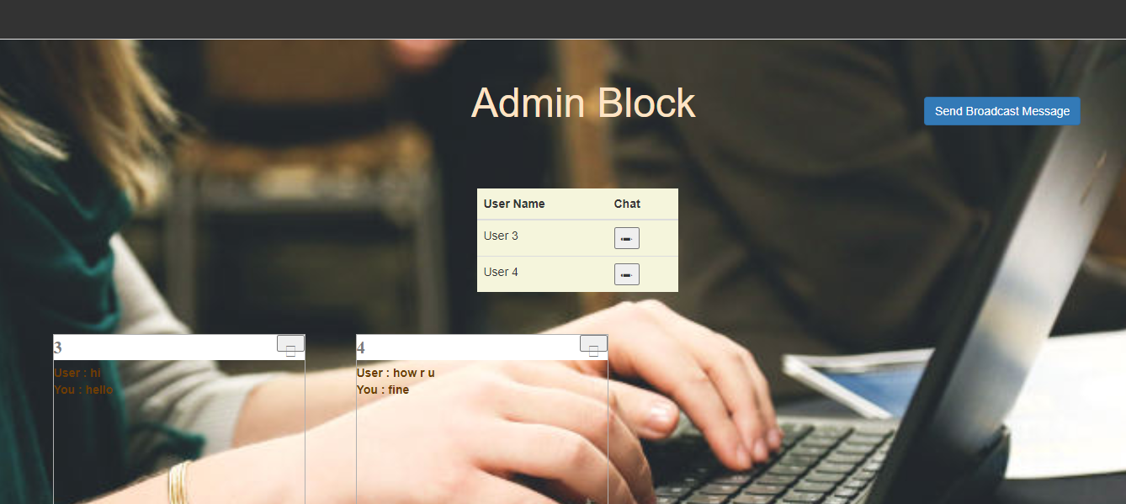
Admin end

Slide 7
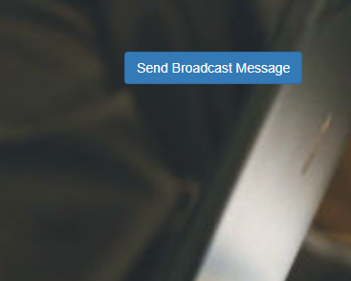
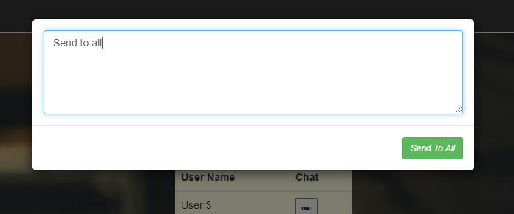
To send broadcast message

Slide 8
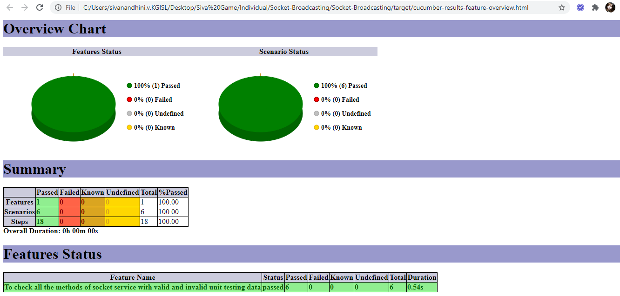
Cucumber report

